Slide 1
SleepCareKit Progress & Algorithm
2018-08-23
RTLAB 전영준

Slide 2
A Table of Contents
01
SleepCareKit Overview
02
Setting & Operating
03
ARL Algorithm FlowChart
04
Further work

Slide 3


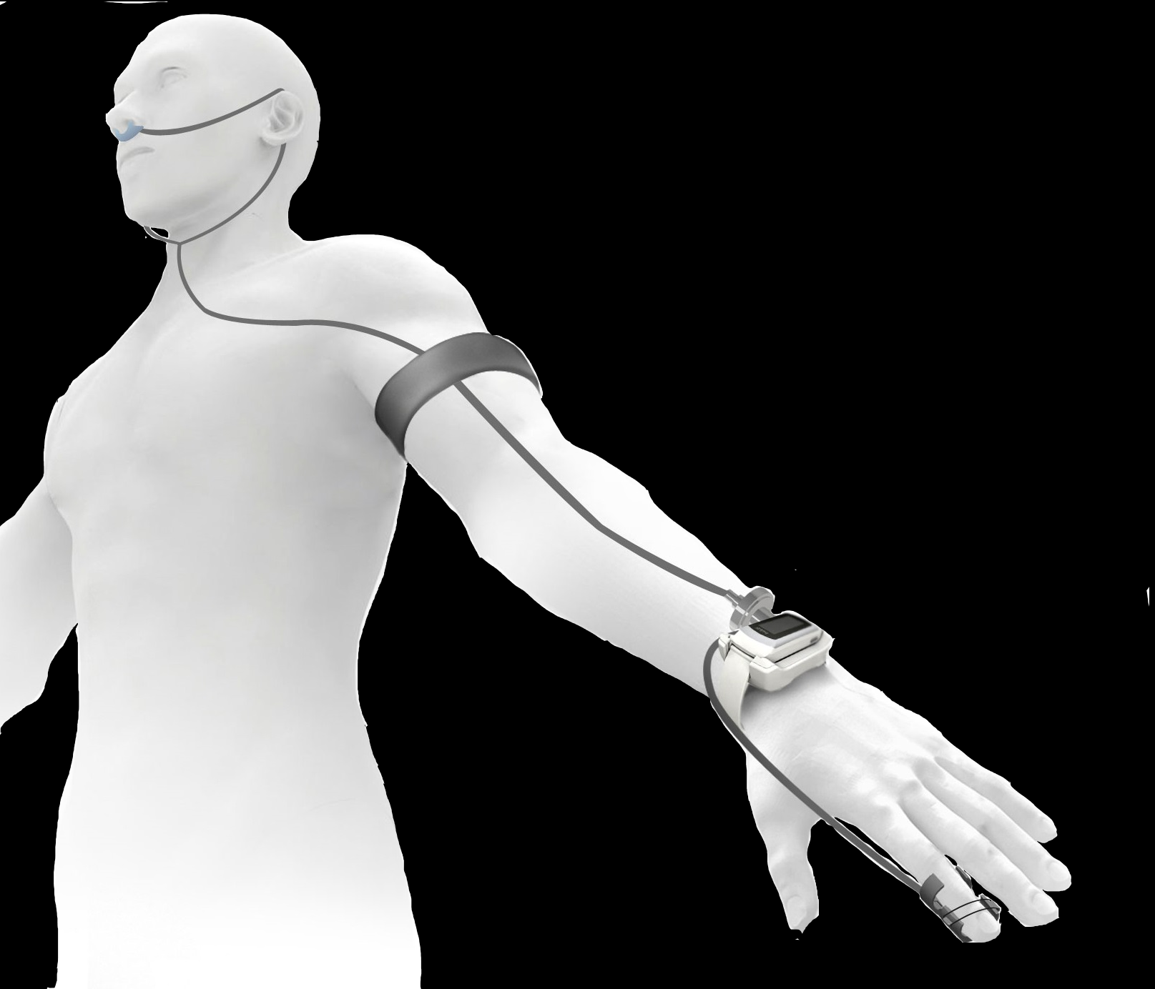
SleepCareKit Overview
PAAR TAG & Pillow
Head Posture Detection
pressure Sensor
Air Pad Control
Secure airway
Posture Control
Apnea warning Message
Homecare Kit
Bio-Signal
PPG
ACC
Breath
Apnea Detection (Spo2 & Breath )
Posture Determination( ACC )
Apnea Risk Level Algorithm

Slide 4
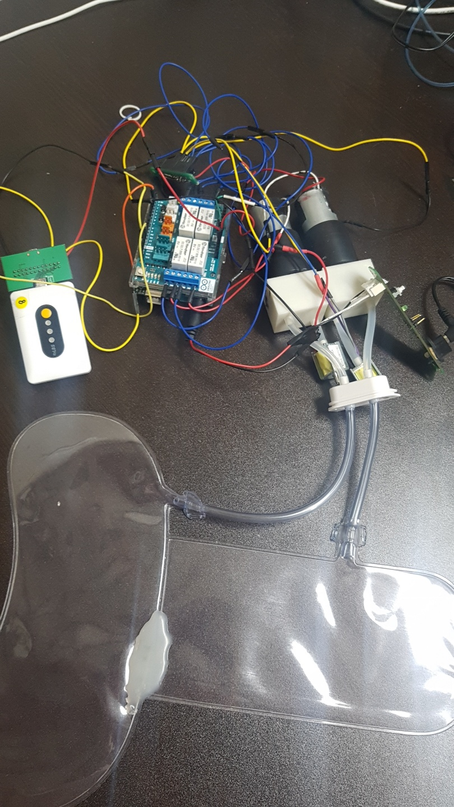
PAAR TAG : BLE communication with PAAR Band and UART communication with Arduino
Arduino : UART communication with Arduino & Motor Relay Control
The part that supplies two motors and two valves power at once
Two Air-Motors for injecting air and two valves for bleeding
Neck Air-Pad to secure airway and Head Air-Pad to lift head

Slide 5

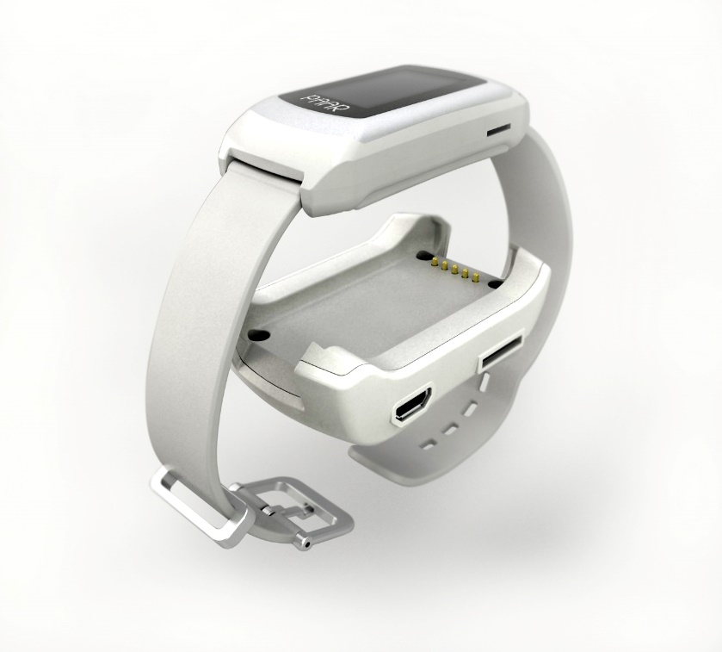

Before Measurement
After Measurement
Slave
Master
Slave
Master

Slide 6
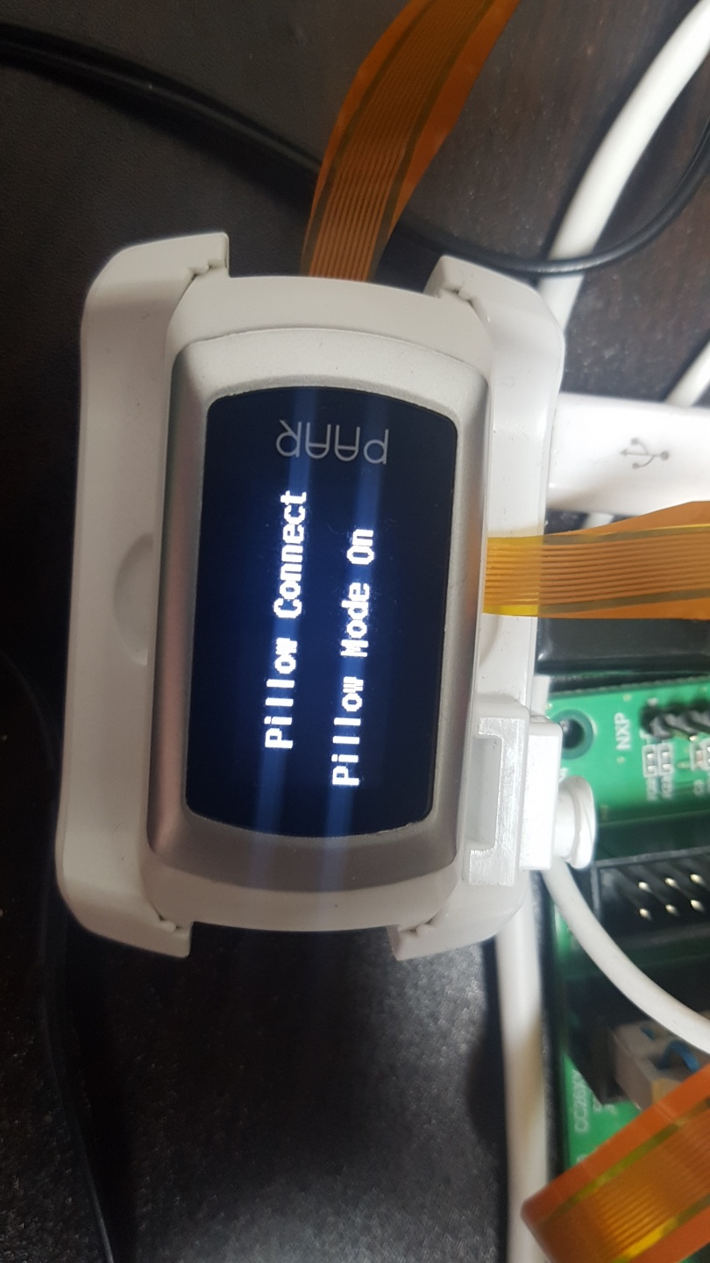
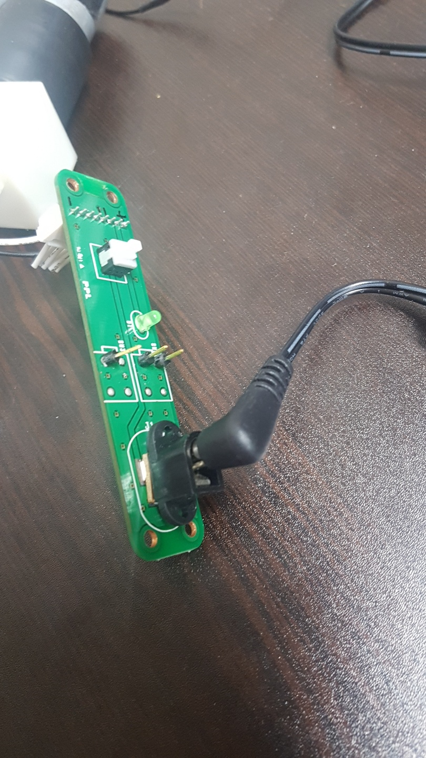
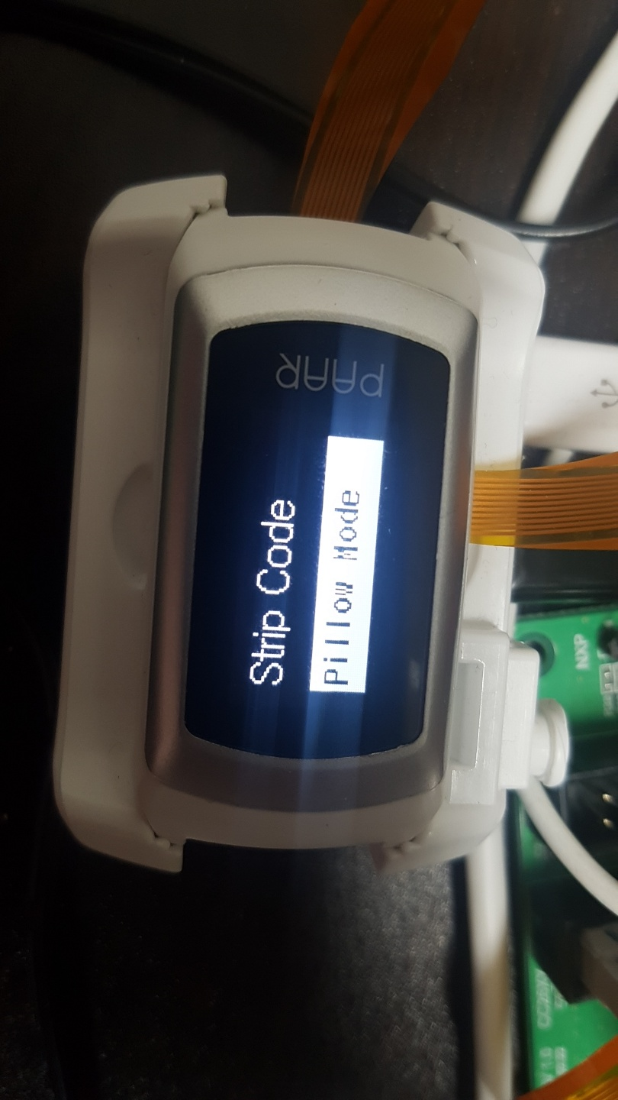
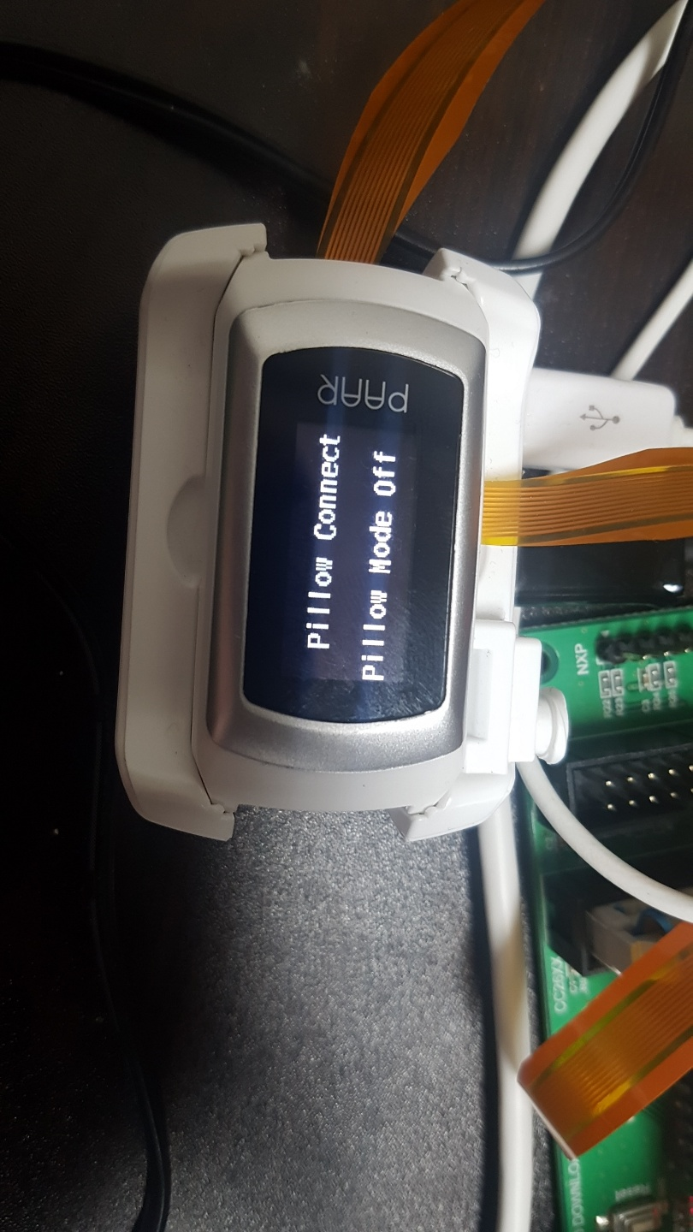
Setting & Operating
TAG & Arduino Power
PAAR Band Setting

Slide 7

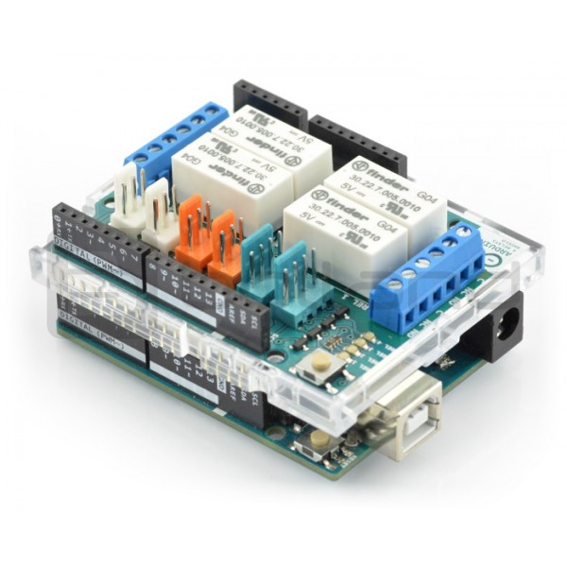
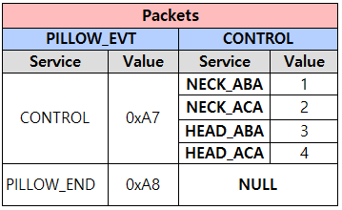
Transmit Breathe Min, Max, Avg and Spo2 values every second
Apnea Risk Level Algorithm
: Risk Level Determination and Pillow Control Setting accordingly

Slide 8
ARL Algorithm FlowChart
Breathe Min, Max, Avg
Apnea Level Breathe
Apnea Interval
Spo2 Value Min, Max
Apnea Level Spo2
Determine Apnea Risk Level

Slide 9
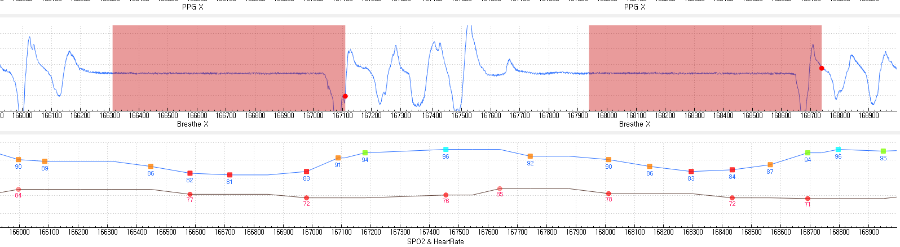
ARL Algorithm FlowChart
Apnea Start Point
Apnea End Point
Apnea Start Point
Apnea End Point
Apnea Interval
Spo2 ( Min, Max, Deviation )
B_Max, B_Min, B_Avg : Current Breathe Min, Max, Average, B_Count : Time of breathing B_avg_diff(Breathe Average Diff) = abs( Breathe_average_First – Breathe_average_Current )
apnea_time : Time duration of apnea, if it exceeds 10 seconds, it is judged to be apnea
S_Max, S_Min : Current Spo2 Min, Max
S_Min : Current apnea interval minimum Spo2
spo2_cnt_dec, spo2_cnt_inc : spo2 Variable for the minimum value check
Apnea_interval_enable : Variables for checking the interval between apneas
Apnea_level : Increased levels at 10-second intervals with apnea

Slide 10
Further work
Measurement test required
1) It is not easy to check Spo2 reduction interval without apnea
2) Actual pillow construction is required. Will be produced next week
Apnea Risk Level Algorithm - Apnea error condition must be assumed
1) When only Spo2 decreases
2) When only apnea occurs (Spo2 does not decrease)
Motion check using accelerometer
- Relationship between apnea and posture
- Decrease Spo2 due to movement that is not apnea

Slide 11
Thank you

